Slide 1
UGEA 4333 Image Processing Image Processing of Ammonia Water Test
Group 1:
Tan Li Kar
Tan Ing Ming
Yip Yuan Ting
Lim Wan Xiang

Slide 2
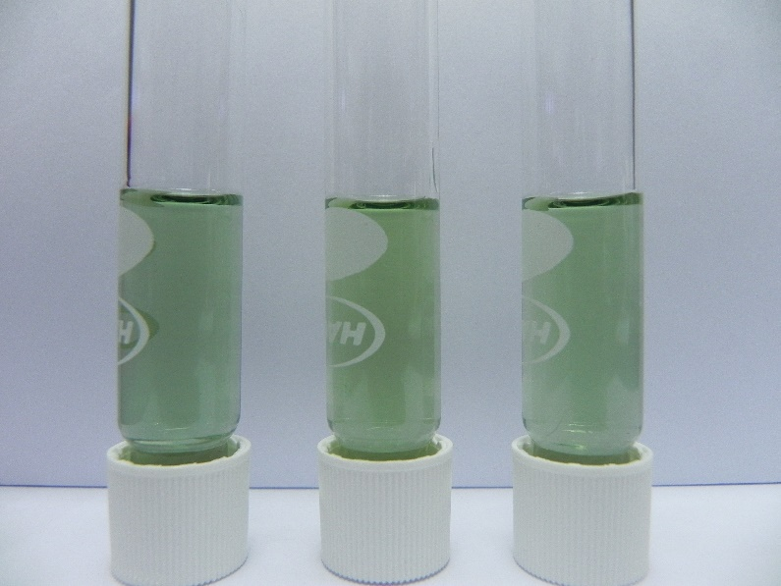
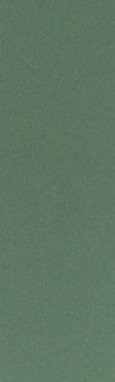
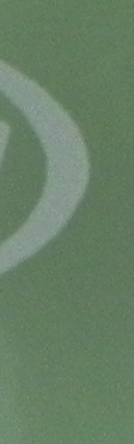
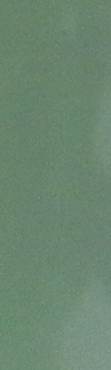
Extraction of Region of Interest
The ROI is cropped from the original image.

Slide 3


Removing Test Tube design
The Cropped Image is filtered using a Median Filter to remove the design on the test tube.

Slide 4



Removing Shading in the Image
The image is filtered using an Average filter to remove the shading in the Image.

Slide 5
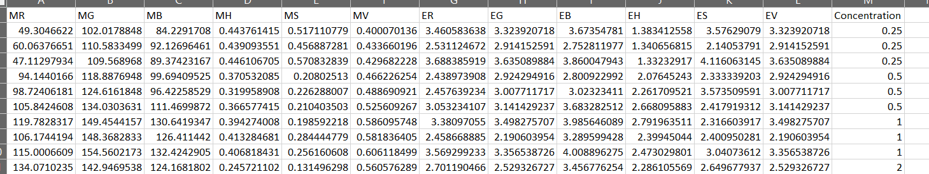
Extracting the Feature of Image
The mean and entropy of Red, Green, Blue, Hue, Saturation and Value of the image are extracted and save into a excel file.

Slide 6
Predicting Ammonia Concentration
This is a classification problem
Machine learning models used in this project are:
Random Forest
Decision Tree
Naïve Bayes

Slide 7
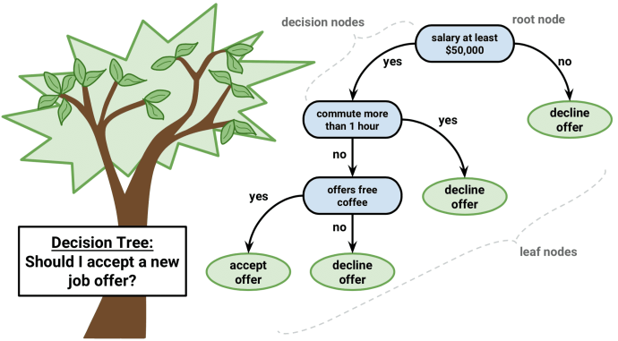
Decision Tree
Decision Tree Algorithm Pseudocode
Place the best attribute of the dataset at the root of the tree.
Split the training set into subsets. Subsets should be made in such a way that each subset contains data with the same value for an attribute.
Repeat step 1 and step 2 on each subset until you find leaf nodes in all the branches of the tree.

Slide 8
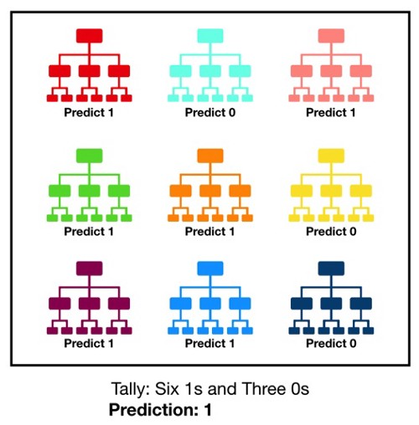
Random Forest
consists of many decision trees.
To classify a new instance, each decision tree provides a classification for input data
random forest collects the classifications and chooses the most voted prediction as the result.

Slide 9

Naïve Bayes
Based on Bayes theorem
Determine the probability of y happening, given that X has occurred.
Where
Variable y is the Output (Concentration of Ammonia)
Variable X represent the parameters/features.

